Slide 1
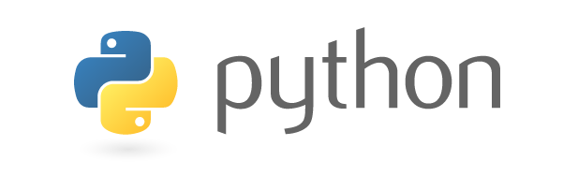
COMP-SCI 5590 - 0001 Special Topics
Introduction To Python
A readable, dynamic, pleasant, flexible, fast and powerful language

Slide 2
For More Information?
http://python.org/
http://diveintopython.org/
http://djangoproject.com/
-documentation, tutorials, beginners guide, core distribution,

Slide 3
General Information
Unlike C/C++ or Java, Python statements do not end in a semicolon
In Python, indentation is the way you indicate the scope of a conditional, function, etc.
Look, no braces!
Python is interpretive, meaning you don’t have to write programs.
You can just enter statements into the Python environment and they’ll execute
For the most part, we’ll be writing programs

Slide 4
Why do people use Python…?
The following primary factors cited by Python users seem to be these:
Python is object-oriented
Structure supports such concepts as polymorphism, operation overloading, and multiple inheritance.
Indentation
Indentation is one of the greatest future in Python.
It's free (open source)
Downloading and installing Python is free and easy
Source code is easily accessible

Slide 5
It's powerful
- Dynamic typing
- Built-in types and tools
- Library utilities
- Third party utilities (e.g. Numeric, NumPy, SciPy)
- Automatic memory management
It's portable
- Python runs virtually every major platform used today
- As long as you have a compatible Python interpreter installed, Python programs will run in exactly the same manner, irrespective of platform.

Slide 6
It's mixable
Python can be linked to components written in other languages easily
Linking to fast, compiled code is useful to computationally intensive problems
Python/C integration is quite common
It's easy to use
No intermediate compile and link steps as in C/ C++
Python programs are compiled automatically to an intermediate form called bytecode, which the interpreter then reads
This gives Python the development speed of an interpreter without the performance loss inherent in purely interpreted languages
It's easy to learn
Structure and syntax are pretty intuitive and easy to grasp

Slide 7
What sort of language is Python?
Compiled
Interpreted
Explicitly
compiled
to machine
code
Explicitly
compiled
to byte
code
Implicitly
compiled
to byte
code
Purely
interpreted
C, C++,
Fortran
Java, C#
Python
Shell,
Perl
Notes:
What sort of language is Python? The naïve view of computer languages is that they come as either compiled languages or interpreted languages.
At the strictly compiled end languages like C, C++ or Fortran are "compiled" (converted) into raw machine code for your computer. You point your CPU at that code and it runs.
Slightly separate from the strictly compiled languages are languages like Java and C# (or anything running in the .net framework). You do need to explicitly compile these programming languages but they are compiled to machine code for a fake CPU which is then emulated on whichever system you run on.
Then there is Python. Python does not have to be explicitly compiled but behind the scenes there is a system that compiles Python into an intermediate code which is stashed away to make things faster in future.
But it does this without you having to do anything explicit yourself. So from the point of view of how you use it you can treat it as a purely interpreted language like the shell or Perl.

Slide 8
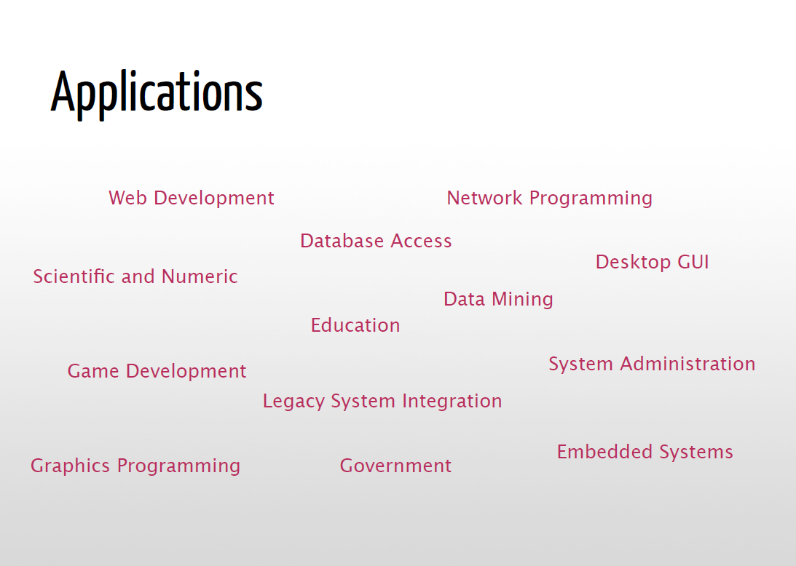
Applications
Science
- Bioinformatics
System Administration
-Unix
-Web logic
-Web sphere
Web Application Development
-CGI
-Jython – Servlets
Testing scripts

Slide 9
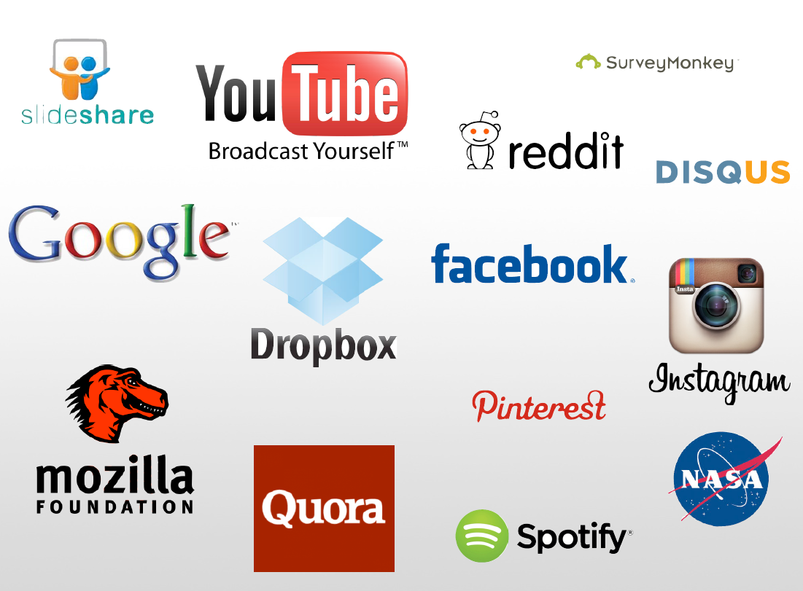
Who uses python today…
Python is being applied in real revenue-generating products by real companies. For instance:
Google makes extensive use of Python in its web search system, and employs Python’s creator.
Intel, Cisco, Hewlett-Packard, Seagate, Qualcomm, and IBM use Python for hardware testing.
ESRI uses Python as an end-user customization tool for its popular GIS mapping products.
The YouTube video sharing service is largely written in Python
The list goes on…….

Slide 10
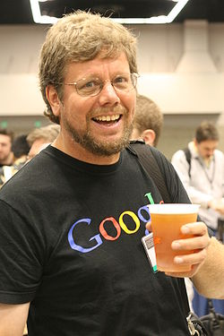
Who created Python?
"My original motivation for creating Python was the perceived need for a higher level language in the Amoeba [Operating Systems] project.
I realized that the development of system administration utilities in C was taking too long. Moreover, doing these things in the Bourne shell wouldn't work for a variety of reasons. ...
So, there was a need for a language that would bridge the gap between C and the shell”
Guido Van Rossum
-The Creator

Slide 11
Installation ??

Slide 12
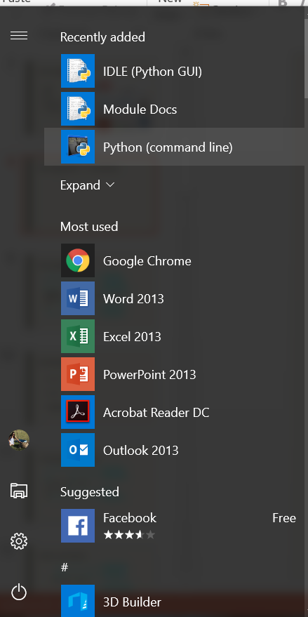
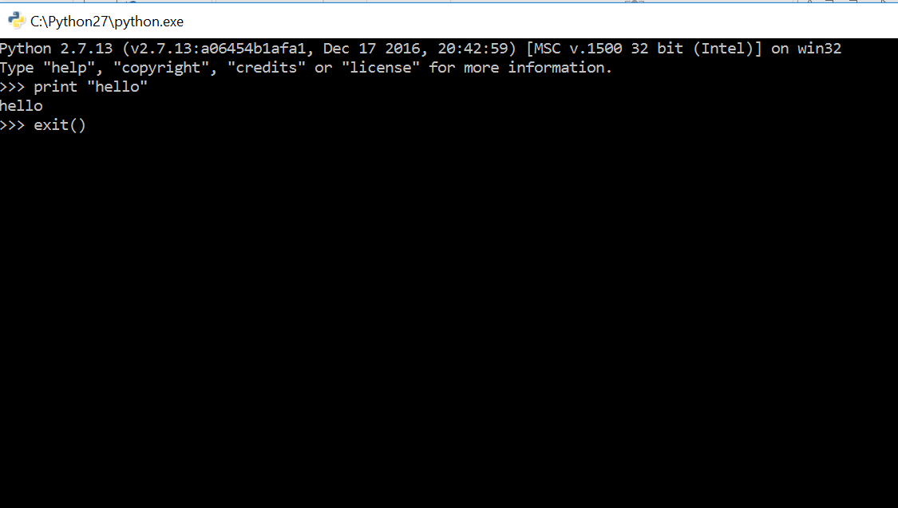
Running Python ― 1 (Windows)
Notes:
Now, the Unix interpreter prompts you to give it a Unix command with a short bit of text that ends with a dollar. In the slides this will be represented simply as a dollar.
This is a Unix prompt asking for a Unix command.
The Unix command we are going to give is “python3”. Please note that trailing “3”. The command “python” gives you either Python 2 or Python 3 depending on what system you are on. With this command we are insisting on getting a version of Python 3.
The Python interpreter then runs, starting with a couple of lines of blurb. In particular it identifies the specific version of Python it is running. (3.2.3 in this slide.)
Then it gives a prompt of its own, three “greater than” characters. The Python 3 program is now running and it is prompting us to give a Python command.
You cannot give a Unix command at a Python prompt (or vice versa).

Slide 13
Running Python ― 2 ( UNIX)
Unix prompt
Unix command
Introductory blurb
$
python3
Python
3.2.3
(default, May 23 2017, 15:54:42)
[GCC 4.6.3] on linux2
>>>
Python version
Python prompt
Notes:
Now, the Unix interpreter prompts you to give it a Unix command with a short bit of text that ends with a dollar. In the slides this will be represented simply as a dollar.
This is a Unix prompt asking for a Unix command.
The Unix command we are going to give is “python3”. Please note that trailing “3”. The command “python” gives you either Python 2 or Python 3 depending on what system you are on. With this command we are insisting on getting a version of Python 3.
The Python interpreter then runs, starting with a couple of lines of blurb. In particular it identifies the specific version of Python it is running. (3.2.3 in this slide.)
Then it gives a prompt of its own, three “greater than” characters. The Python 3 program is now running and it is prompting us to give a Python command.
You cannot give a Unix command at a Python prompt (or vice versa).

Slide 14
Quitting Python
>>>
exit()
Any one
of these
>>>
quit()
>>>
Ctrl
+
D
Notes:
There are various ways to quit interactive Python. There are two commands which are equivalent for our purposes: quit() and exit(), but the simplest is the key sequence [Ctrl]+[D].

Slide 15
A first Python command
Python prompt
Python command
>>>
print('Hello, world!')
Hello, world!
Output
>>>
Python prompt
Notes:
There is a tradition that the first program you ever run in any language generates the output “Hello, world!”.
I see no reason to buck tradition. Welcome to your first Python command; we are going to output “Hello, world!”.
We type this command at the Python prompt. The convention in these slides is that the typewriter text in bold face is what you type and the text in regular face is what the computer prints.
We type “print” followed by an opening round brackets and the text “Hello, world!” surrounded by single quotes, ending with a closing round bracket and hitting the Return key, [↲], to indicate that we are done with that line of instruction.
The computer responds by outputting “Hello, world!” without the quotes.
Once it has done that it prompts us again asking for another Python command with another Python prompt, “>>>”.

Slide 16
Python commands
Python “function”
Round brackets
― “parentheses”
print
(
(
'Hello, world!'
)
Function’s “argument”
print
≠
PRINT
“Case sensitive”
https://help.uis.cam.ac.uk/help-support/training/downloads/course-files/programming-student-files/python-courses/pythonab/pythonab-files/python3-slides.pdf
Notes:
This is our first Python “function”. A function takes some input, does something with it and (optionally) returns a value. The nomenclature derives from the mathematics of functions, but we don’t need to fixate on the mathematical underpinnings of computer science in this course.
Our function in this case is “print” and the command necessarily starts with the name of the function.
The inputs to the function are called its “arguments” and follow the function inside round brackets (“parentheses”).
In this case there is a single argument, the text to print.
Note that Python, as with many but not all programming languages, is “case sensitive”. The word “print” is not the same as “Print” or “PRINT”.

Slide 17
Python text
Quotation marks
'
Hello, world!
'
The body
of the text
!
The quotes are not
part of the text itself.
https://help.uis.cam.ac.uk/help-support/training/downloads/course-files/programming-student-files/python-courses/pythonab/pythonab-files/python3-slides.pdf
Notes:
The text itself is presented within single quotation marks. (We will discuss the choice of quotation marks later.)
The body of the text comes within the quotes.
The quotes are not part of the text; they merely indicate to the Python interpreter that “hey, this is text!”
Recall that the the printed output does not have quotes.

Slide 18
Quotes?
print
Command
'print'
Text
https://help.uis.cam.ac.uk/help-support/training/downloads/course-files/programming-student-files/python-courses/pythonab/pythonab-files/python3-slides.pdf
Notes:
So what do the quotes “do”?
If there are no quotes then Python will try to interpret the letters as something it should know about. With the quotes Python simply interprets it as literal text.
For example, without quotes the string of characters p-r-i-n-t are a command; with quotes they are the text to be printed.

Slide 19
Python scripts
File in home directory
print('Hello, world!')
Run from Unix prompt
hello1.py
Unix prompt
Unix command
to run Python
$
python3
hello1.py
Python script
Hello, world!
Python script’s output
$
Unix prompt
Notes:
So we understand the “hello, world” command and how to run it from an interactive Python. But serious Python programs can’t be typed in live; they need to be kept in a file and Python needs to be directed to run the commands from that file.
These files are called “scripts” and we are now going to look at the Python script version of “hello, world”.
In your home directories we have put a file called “hello1.py”. It is conventional that Python scripts have file names ending with a “.py” suffix. Some tools actually require it. We will follow this convention and you should too.
This contains exactly the same as we were typing manually: a single line with the print command on it.
We are going to make Python run the instructions out of the script. We call this “running the script”.
Scripts are run from the Unix command line. We issue the Unix command “python3” to execute Python again, but this time we add an extra word: the name of the script, “hello1.py”.
When it runs commands from a script, python doesn’t bother with the lines of blurb and as soon as it has run the commands (hence the output) it exists immediately, returning control to the Unix environment, so we get a Unix prompt back.

Slide 20

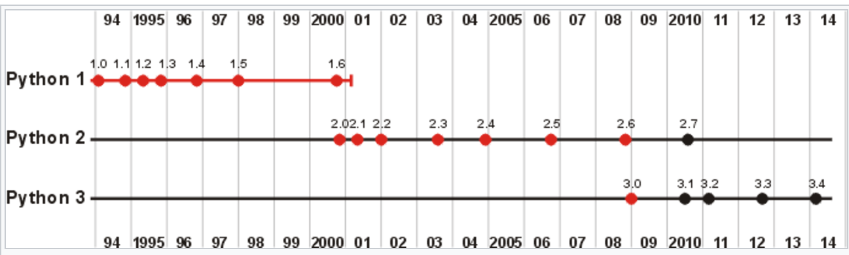
4 Major Versions of Python
“Python” or “CPython” is written in C/C++
- Version 2.7 came out in mid-2010
- Version 3.4 came out in early 2014
“Jython” is written in Java for the JVM
“IronPython” is written in C# for the .Net environment
https://help.uis.cam.ac.uk/help-support/training/downloads/course-files/programming-student-files/python-courses/pythonab/pythonab-files/python3-slides.pdf

Slide 21
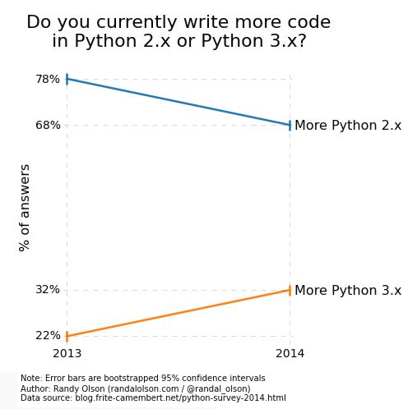
Python 2 vs 3
Learn more from below link:
http://learntocodewith.me/programming/python/python-2-vs-python-3/

Slide 22
Development Environments what IDE to use? http://stackoverflow.com/questions/81584
PyDev with Eclipse
Komodo
Emacs
Vim
TextMate
Gedit
Idle
PIDA (Linux)(VIM Based)
NotePad++ (Windows)
BlueFish (Linux)
PyCharm
Our choice of IDE !!
https://help.uis.cam.ac.uk/help-support/training/downloads/course-files/programming-student-files/python-courses/pythonab/pythonab-files/python3-slides.pdf

Slide 23
Pydev with Eclipse

Slide 24
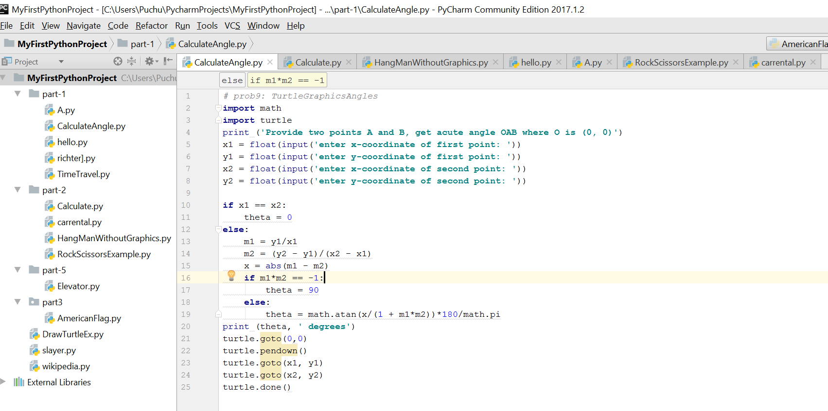
Pycharm IDE
Python File Name
Project Name

Slide 25
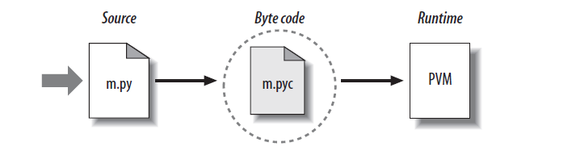
Python Code Execution
Python’s traditional runtime execution model: source code you type is translated to byte code, which is then run by the Python Virtual Machine. Your code is automatically compiled, but then it is interpreted.
Source code extension is .py
Byte code extension is .pyc (compiled python code)

Slide 26
Start >>>

Slide 27
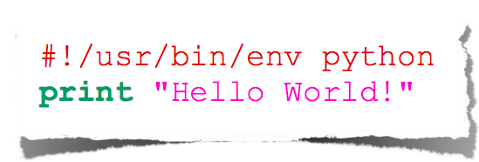
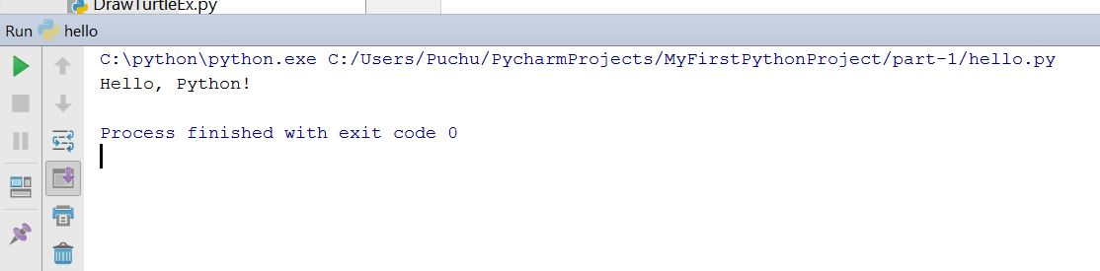
Usecase 1 - Hello World
Output
hello_world.py
Input Sample Program

Slide 28
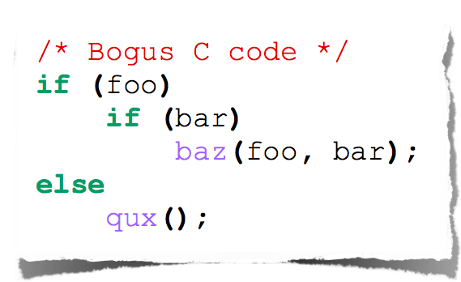
Indentation
Most languages don’t care about indentation
Most humans do
We tend to group similar things together
The else here actually belongs to the 2nd if statement

Slide 29
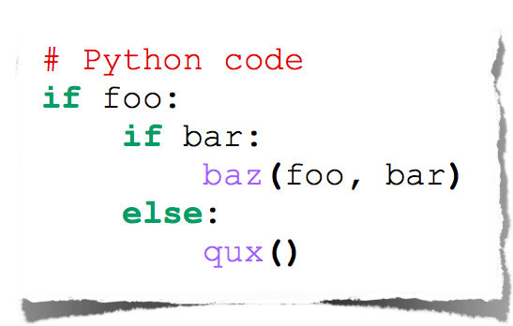
Indentation
Text
Python embraces indentation

Slide 30
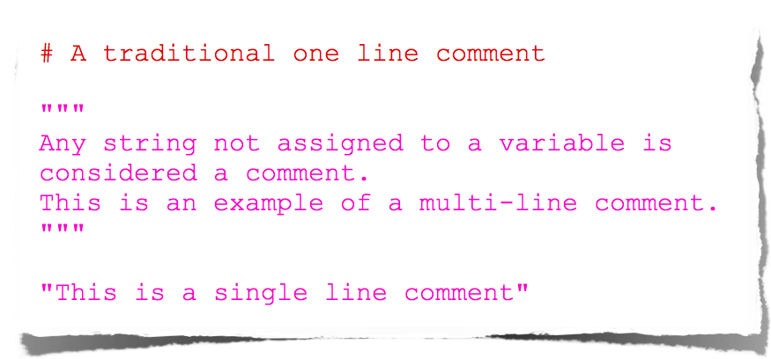
Comments

Slide 31
Types

Slide 32
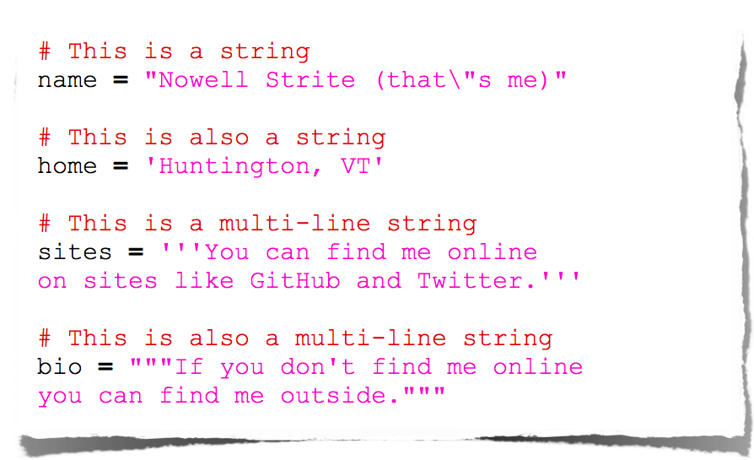
Strings

Slide 33
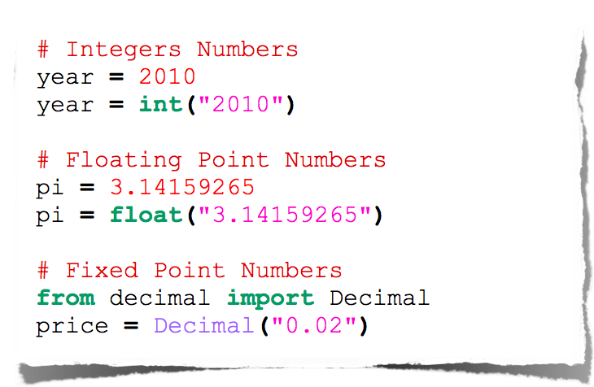
Numbers

Slide 34
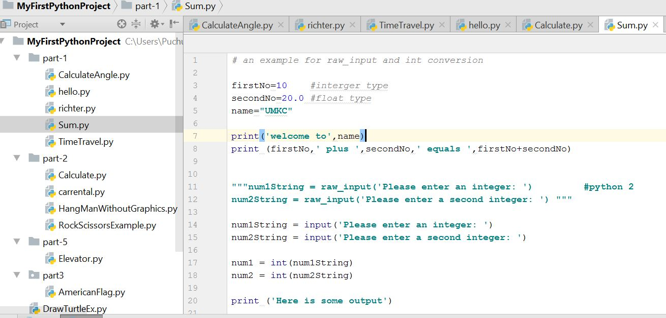
Use case 2- Add two numbers
Variable declaration
Print statement
Python 2 way
Taking Input from user

Slide 35
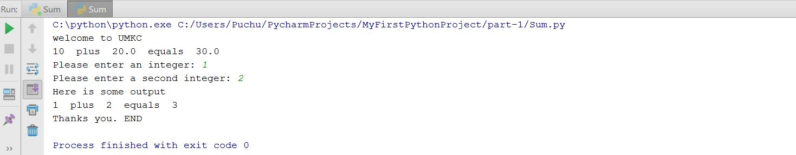
Use case 2- Output

Slide 36
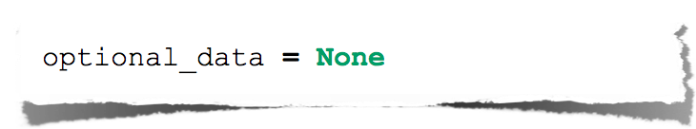
Null

Slide 37
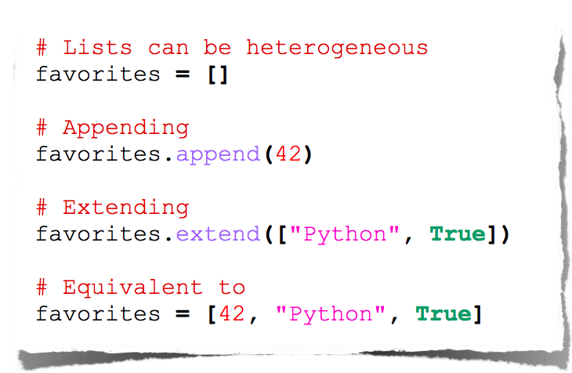
Lists

Slide 38
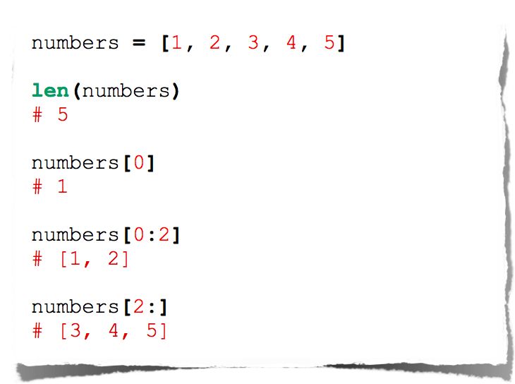
Lists

Slide 39
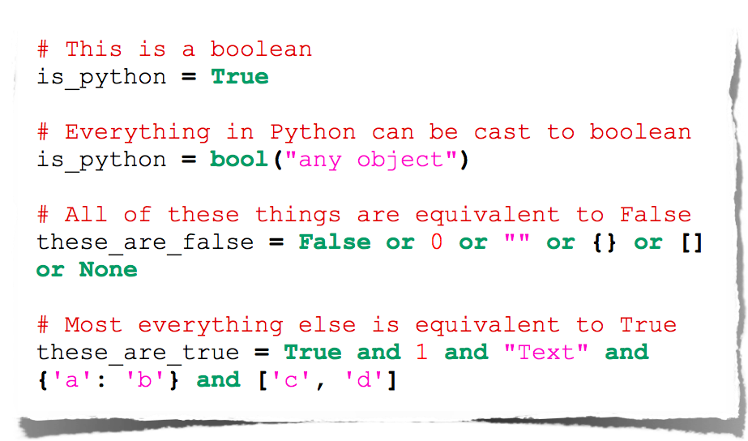
Booleans

Slide 40
Operators

Slide 41
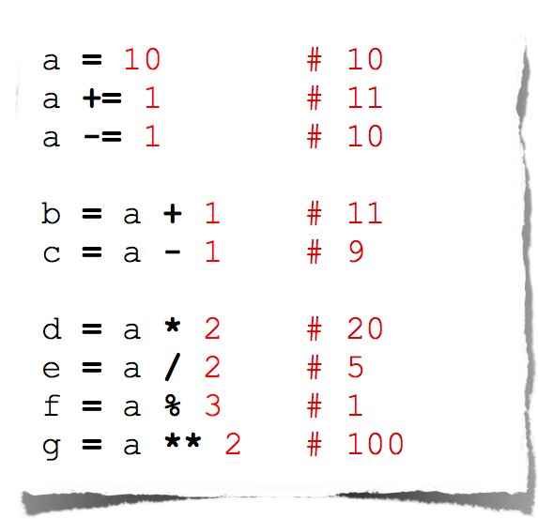
Arithmetic

Slide 42
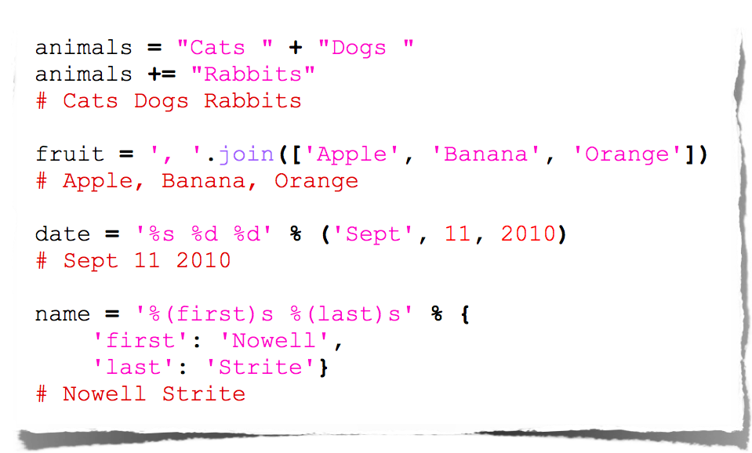
String Manipulation

Slide 43
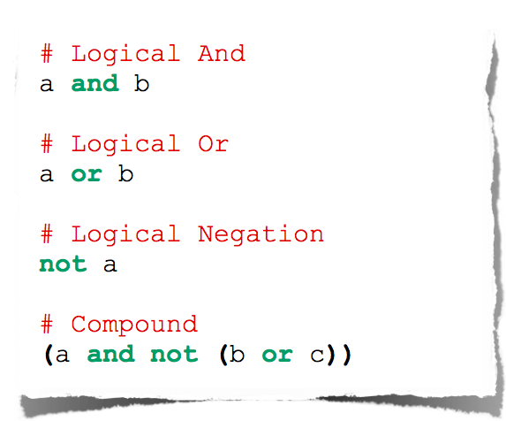
Logical Comparison

Slide 44
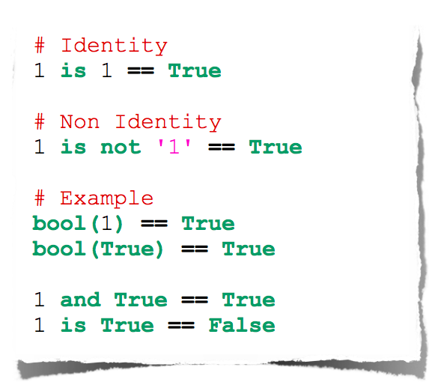
Identity Comparison

Slide 45
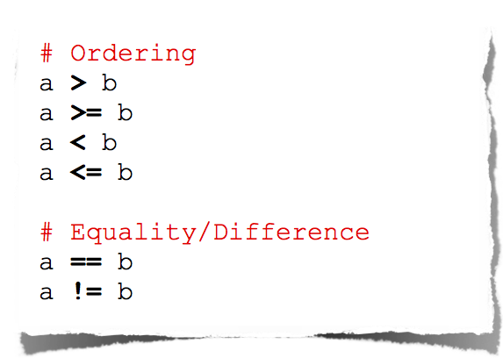
Arithmetic Comparison

Slide 46
Operators Precedence
Operator | Description
** | Exponentiation (raise to the power)
~ + - | Complement, unary plus and minus (method names for the last two are +@ and -@)
* / % // | Multiply, divide, modulo and floor division
+ - | Addition and subtraction
>> << | Right and left bitwise shift
& | Bitwise 'AND'
^ | | Bitwise exclusive `OR' and regular `OR'
<= < > >= | Comparison operators
<> == != | Equality operators
= %= /= //= -= += *= **= | Assignment operators
is is not | Identity operators
in not in | Membership operators
not or and | Logical operators
The order in which operators are executed in any expression

Slide 47
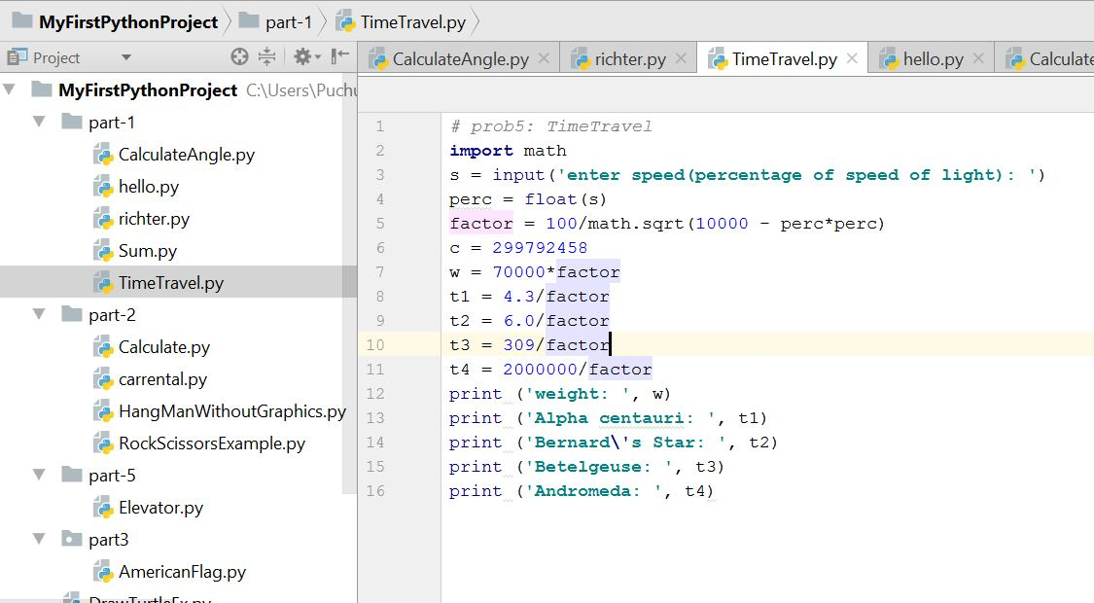
Use case 3- Basic operations
Basic Operations

Slide 48
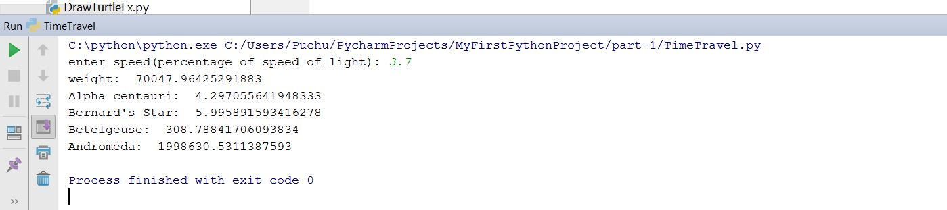
Use case 3- Output

Slide 49
Importing and Modules
Use classes & functions defined in another file to get additional functionality
A Python module is a file with the same name (plus the .py extension)
Like Java import, C++ include
modules have private symbol tables
avoids name clash for global variables
accessible as module.globalname
Three formats of the command:
import somefile
from somefile import *
from somefile import className
When a Python program starts it only has access to a basic functions and classes.
(“int”, “dict”, “len”, “sum”, “range”, ...)

Slide 50
import …
import somefile
Everything in somefile.py gets imported.
To refer to something in the file, append the text “somefile.” to the front of its name:
somefile.className.method(“abc”)
somefile.myFunction(34)

Slide 51
from … import *
from somefile import *
Everything in somefile.py gets imported
To refer to anything in the module, just use its name. Everything in the module is now in the current namespace.
Take care! Using this import command can easily overwrite the definition of an existing function or variable!
className.method(“abc”)
myFunction(34)

Slide 52
from … import …
from somefile import className
Only the item className in somefile.py gets imported.
After importing className, you can just use it without a module prefix. It’s brought into the current namespace.
Take care! Overwrites the definition of this name if already defined in the current namespace!
className.method(“abc”) ⬅ imported
myFunction(34) ⬅ Not imported

Slide 53
import the math module
>>> import math
>>> math.pi
3.1415926535897931
>>> math.cos(0)
1.0
>>> math.cos(math.pi)
-1.0
>>> dir(math)
['__doc__', '__file__', '__name__', '__package__', 'acos', 'acosh',
'asin', 'asinh', 'atan', 'atan2', 'atanh', 'ceil', 'copysign', 'cos',
'cosh', 'degrees', 'e', 'exp', 'fabs', 'factorial', 'floor', 'fmod',
'frexp', 'fsum', 'hypot', 'isinf', 'isnan', 'ldexp', 'log', 'log10',
'log1p', 'modf', 'pi', 'pow', 'radians', 'sin', 'sinh', 'sqrt', 'tan',
'tanh', 'trunc']

Slide 54
Giving local name
Use modules via "name space":
  >>> fibo.fib(1000)
  >>> fibo.__name__
  'fibo'
can give it a local name:
  >>> fib = fibo.fib
  >>> fib(500)

Slide 55
Basic Statements: The If Statement (1)
If statements have the following basic structure:
# inside the interpreter # inside a script
>>> if condition: if condition:
... action action
...
>>>
Subsequent indented lines are assumed to be part of the if statement. The same is true for most other types of python statements. A statement typed into an interpreter ends once an empty line is entered, and a statement in a script ends once an unindented line appears. The same is true for defining functions.
If statements can be combined with else if (elif) and else statements as follows:
if condition1: # if condition1 is true, execute action1
action1
elif condition2: # if condition1 is not true, but condition2 is, execute
action2 # action2
else: # if neither condition1 nor condition2 is true, execute
action3 # action3

Slide 56
Basic Statements: The If Statement (2)
Conditions in if statements may be combined using and & or statements
if condition1 and condition2:
action1
# if both condition1 and condition2 are true, execute action1
if condition1 or condition2:
action2
# if either condition1 or condition2 is true, execute action2
Conditions may be expressed using the following operations:
<, <=, >, >=, ==, !=, in
Somewhat unrealistic example:
>>> x = 2; y = 3; L = [0,1,2]
>>> if (1<x<=3 and 4>y>=2) or (1==1 or 0!=1) or 1 in L:
... print 'Hello world'
...
Hello world
>>>

Slide 57
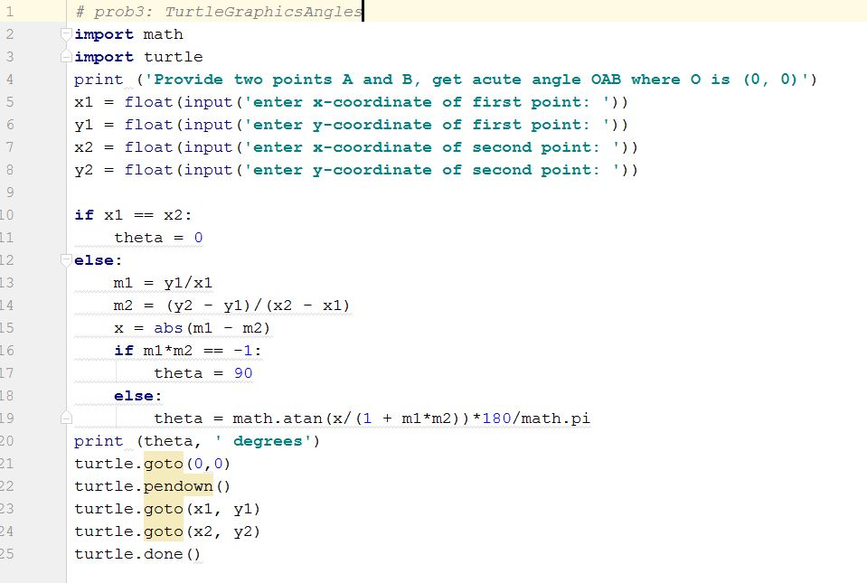
Use Case 4 – Import Turtle Graphics and create the two lines. Also calculate angle between them
Import statements
If block

Slide 58
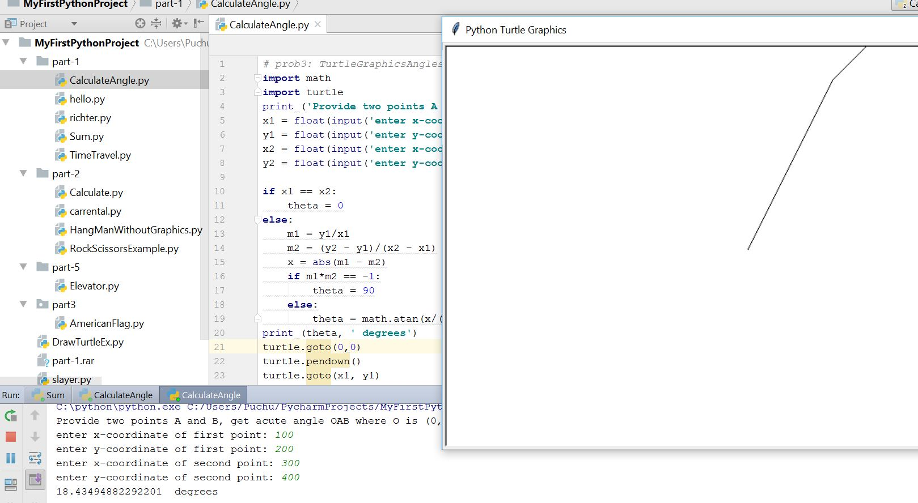
Use Case 4 -Output

Slide 59
Loops: break, continue, else
break and continue like C
else after loop exhaustion
for n in range(2,10):
for x in range(2,n):
if n % x == 0:
print n, 'equals', x, '*', n/x
break
else:
# loop fell through without finding a factor
print n, 'is prime'

Slide 60
Basic Statements: The While Statement (1)
While statements have the following basic structure:
# inside the interpreter # inside a script
>>> while condition: while condition:
... action action
...
>>>
As long as the condition is true, the while statement will execute the action
Example:
>>> x = 1
>>> while x < 4: # as long as x < 4...
... print x**2 # print the square of x
... x = x+1 # increment x by +1
...
1 # only the squares of 1, 2, and 3 are printed, because
4 # once x = 4, the condition is false
9
>>>

Slide 61
Basic Statements: The While Statement (2)
Pitfall to avoid:
While statements are intended to be used with changing conditions. If the condition in a while statement does not change, the program will be stuck in an infinite loop until the user hits ctrl-C.
Example:
>>> x = 1
>>> while x == 1:
... print 'Hello world'
...
Since x does not change, Python will continue to print “Hello world” until interrupted
Do nothing : pass does nothing
syntactic filler
while 1:
pass

Slide 62
Basic Statements: The For Statement (1)
For statements have the following basic structure:
for item i in set s:
action on item i
# item and set are not statements here; they are merely intended to clarify the relationships between i and s
Example:
>>> for i in range(1,7):
... print i, i**2, i**3, i**4
...
1 1 1 1
2 4 8 16
3 9 27 81
4 16 64 256
5 25 125 625
6 36 216 1296
>>>

Slide 63
Basic Statements: The For Statement (2)
The item i is often used to refer to an index in a list, tuple, or array
Example:
>>> L = [0,1,2,3] # or, equivalently, range(4)
>>> for i in range(len(L)):
... L[i] = L[i]**2
...
>>> L
[0,1,4,9]
>>>
Of course, we could accomplish this particular task more compactly using arrays:
>>> L = arange(4)
>>> L = L**2
>>> L
[0,1,4,9,]

Slide 64
Range
The range function specifies a range of integers:
range(start, stop) - the integers between start (inclusive)
and stop (exclusive)
It can also accept a third value specifying the change between values.
range(start, stop, step) - the integers between start (inclusive)
and stop (exclusive) by step

Slide 65
Basic Statements: Combining Statements
The user may combine statements in a myriad of ways
Example:
>>> L = [0,1,2,3] # or, equivalently, range(4)
>>> for i in range(len(L)):
... j = i/2.
... if j – int(j) == 0.0:
... L[i] = L[i]+1
... else: L[i] = -i**2
...
>>> L
[1,-1,3,-9]
>>>

Slide 66
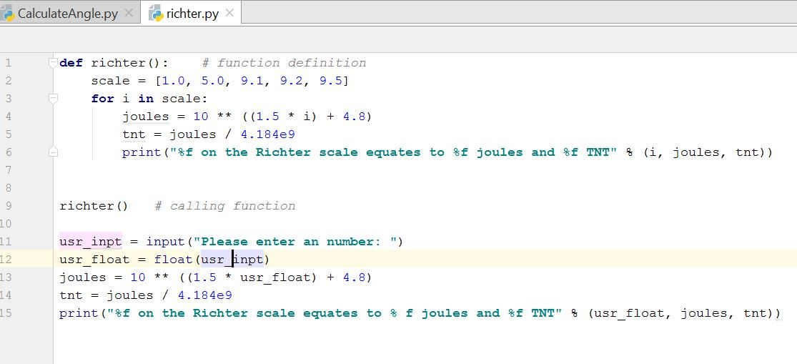
Use Case 5 – Basic for loop
For loop

Slide 67
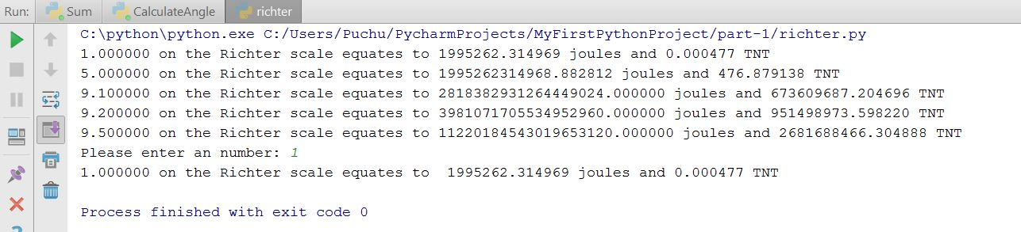
Use Case 5 – Output

Slide 68
References
https://www.slideshare.net/nowells/introduction-to-python-5182313
https://www.slideshare.net/sujithkumar9212301/introduction-to-python-36647807
https://github.com/galactocalypse/python
http://www.cse.msu.edu/~cse231/PracticeOfComputingUsingPython/
https://ocw.mit.edu/courses/electrical-engineering-and-computer-science/6-189-a-gentle-introduction-to-programming-using-python-january-iap-2011/download-course-materials/

Slide 69
Lets start with In class Exercise
State differences between Python 2 and Python 3 version.
Write a python program to
Take radius of a circle as input from user and calculate area , circumference and print it.
Check whether a number input by the user is even or odd
Sample input:
Enter Number: 13
Sample output:
Number entered by user is odd

Slide 70
In Class Exercise
3. This is a number guess exercise. First pick a random digit via program i.e 0,1,2,3,4,5,6,7,8,9
Ask the user to guess the digit randomly picked by your program. Then print whether the number guess by the user is perfect or below the random number or above the random number. Also your program should explain the rules of this number guess game to the user.
Hint: *** use random module. You need to use import statement here.

Slide 71
In Class Exercise
Suppose the digit generated by program is 8
Sample input:
Guess the digit: 7
Sample output:
Your answer is low than required
Sample input:
Guess the digit: 8
Sample output:
Your answer is PERFECT!! Congratulations!!
Sample input:
Guess the digit: 9
Sample output:
Your answer is high than required

